Slide 1

Medizap – Medicine & Cart Management System
Presented by: Gadhamsetty Akshay Kumar
Student ID: 52336840
Project Guide: Bharat Veerchand Chhajer

Slide 2



Introduction: Revolutionizing Medicine Management
Problem Statement
Existing medicine management processes often suffer from inefficiencies, leading to stock mismanagement, order inaccuracies, and delays in patient care. Manual tracking systems are prone to human error and lack real-time visibility into inventory and sales data.
Proposed Solution
Medizap offers a comprehensive digital solution designed to streamline the management of medicines and associated carts. It provides an intuitive platform for efficient inventory control, accurate order processing, and enhanced operational transparency within healthcare settings.
This system aims to simplify complex workflows, reduce operational costs, and ultimately improve the reliability of medicine availability for healthcare providers and patients.

Slide 3





Project Objectives: Core Goals
Enhance Efficiency
To automate and optimize the process of tracking medicine inventory and managing shopping carts, minimizing manual intervention and reducing errors.
Ensure Data Accuracy
To maintain precise, real-time data on medicine stock levels and transaction histories, supporting informed decision-making and preventing discrepancies.
Improve User Experience
To deliver a user-friendly and intuitive interface for both medicine administration and cart management, making the system accessible and easy to operate.
Build Scalable Architecture
To develop a robust and scalable system architecture capable of handling increasing data volumes and future feature expansions without compromising performance.

Slide 4
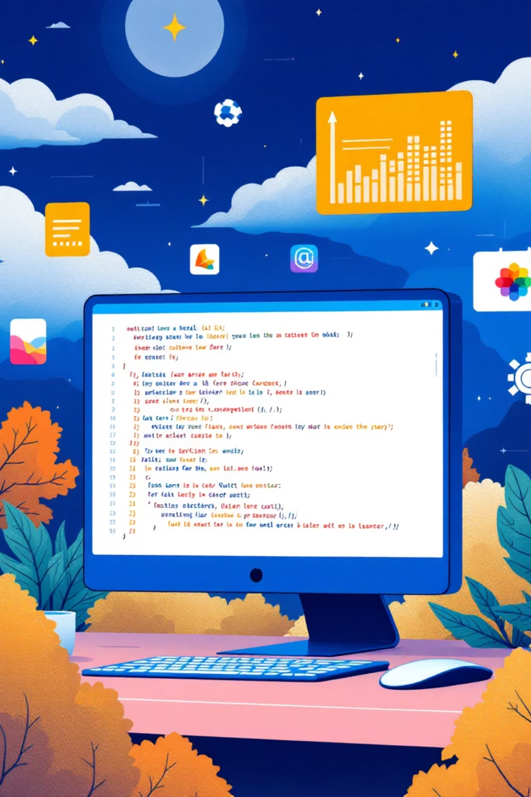



Key Technologies Employed
Spring Boot
Chosen for its rapid application development capabilities, robust ecosystem, and simplified configuration, forming the backbone of our backend services.
React
Utilized for building dynamic and responsive user interfaces, offering a component-based architecture for efficient frontend development and state management.
PostgreSQL
Selected as the primary database for its reliability, advanced features, and strong support for complex data operations, ensuring data integrity and scalability.
This combination provides a powerful, modern stack for developing a highly performant and maintainable application.

Slide 5

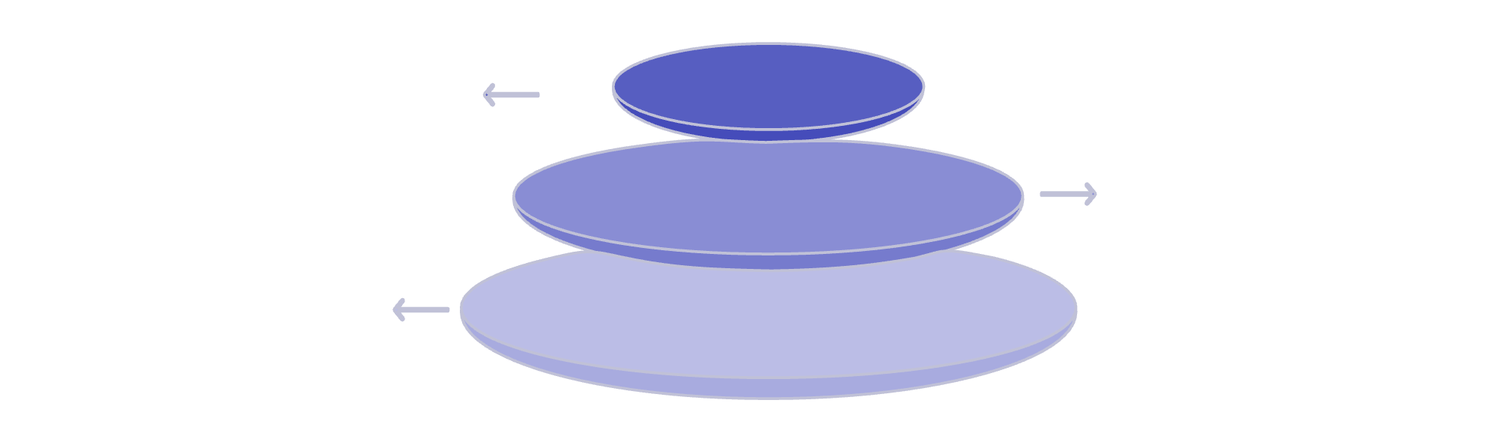
System Architecture Overview
The Medizap system employs a clear separation of concerns, dividing the application into distinct layers to ensure modularity, scalability, and ease of maintenance.
Frontend
User interface for interactions
Backend
Business logic and APIs
Database
Persistent storage of records
This architectural design facilitates independent development and deployment of each component, ensuring a resilient and adaptable system.

Slide 6




Backend Implementation: Core Logic
The backend, powered by Spring Boot, handles all business logic, data persistence, and API endpoints, serving as the central hub for Medizap's operations.
MedicineController
Manages all operations related to medicine entities, including retrieval, addition, update, and deletion of medicine records.
CartController
Facilitates cart-specific functionalities, enabling users to add, update, and remove items from their virtual shopping cart.
REST APIs
Provides standardized interfaces for frontend communication, ensuring secure and efficient data exchange between client and server.
These controllers expose a comprehensive set of RESTful APIs, enabling seamless interaction with the frontend application.

Slide 7



Frontend Implementation: User Interface
Developed with React, the frontend delivers a dynamic and intuitive user experience, allowing users to interact effortlessly with the Medizap system.
Cart.tsx
Medicines.tsx
NotFound.tsx & services/api.ts
Renders the user's shopping cart, displaying selected medicines and quantities, with options to adjust or remove items.
Presents a comprehensive list of available medicines, featuring search, filtering, and options to add items to the cart.
NotFound.tsx: A dedicated component for handling and displaying 404 errors, enhancing user navigation experience. services/api.ts: Manages all API calls to the backend, centralizing data fetching logic and ensuring consistent interaction patterns.
Each component is designed to be modular and reusable, contributing to a clean and maintainable codebase.

Slide 8




Core Features: Empowering Users
Search Medicines
Users can quickly find specific medicines using advanced search functionalities, filtering by name, category, or availability.
Add/Update/Delete Cart
Seamless management of cart contents, allowing users to add new items, modify quantities, or remove medicines effortlessly.
Real-time Stock Management
Provides up-to-the-minute updates on medicine inventory, ensuring accurate stock levels and preventing overselling.
These features collectively enhance operational efficiency and user satisfaction within the Medizap system.

Slide 9

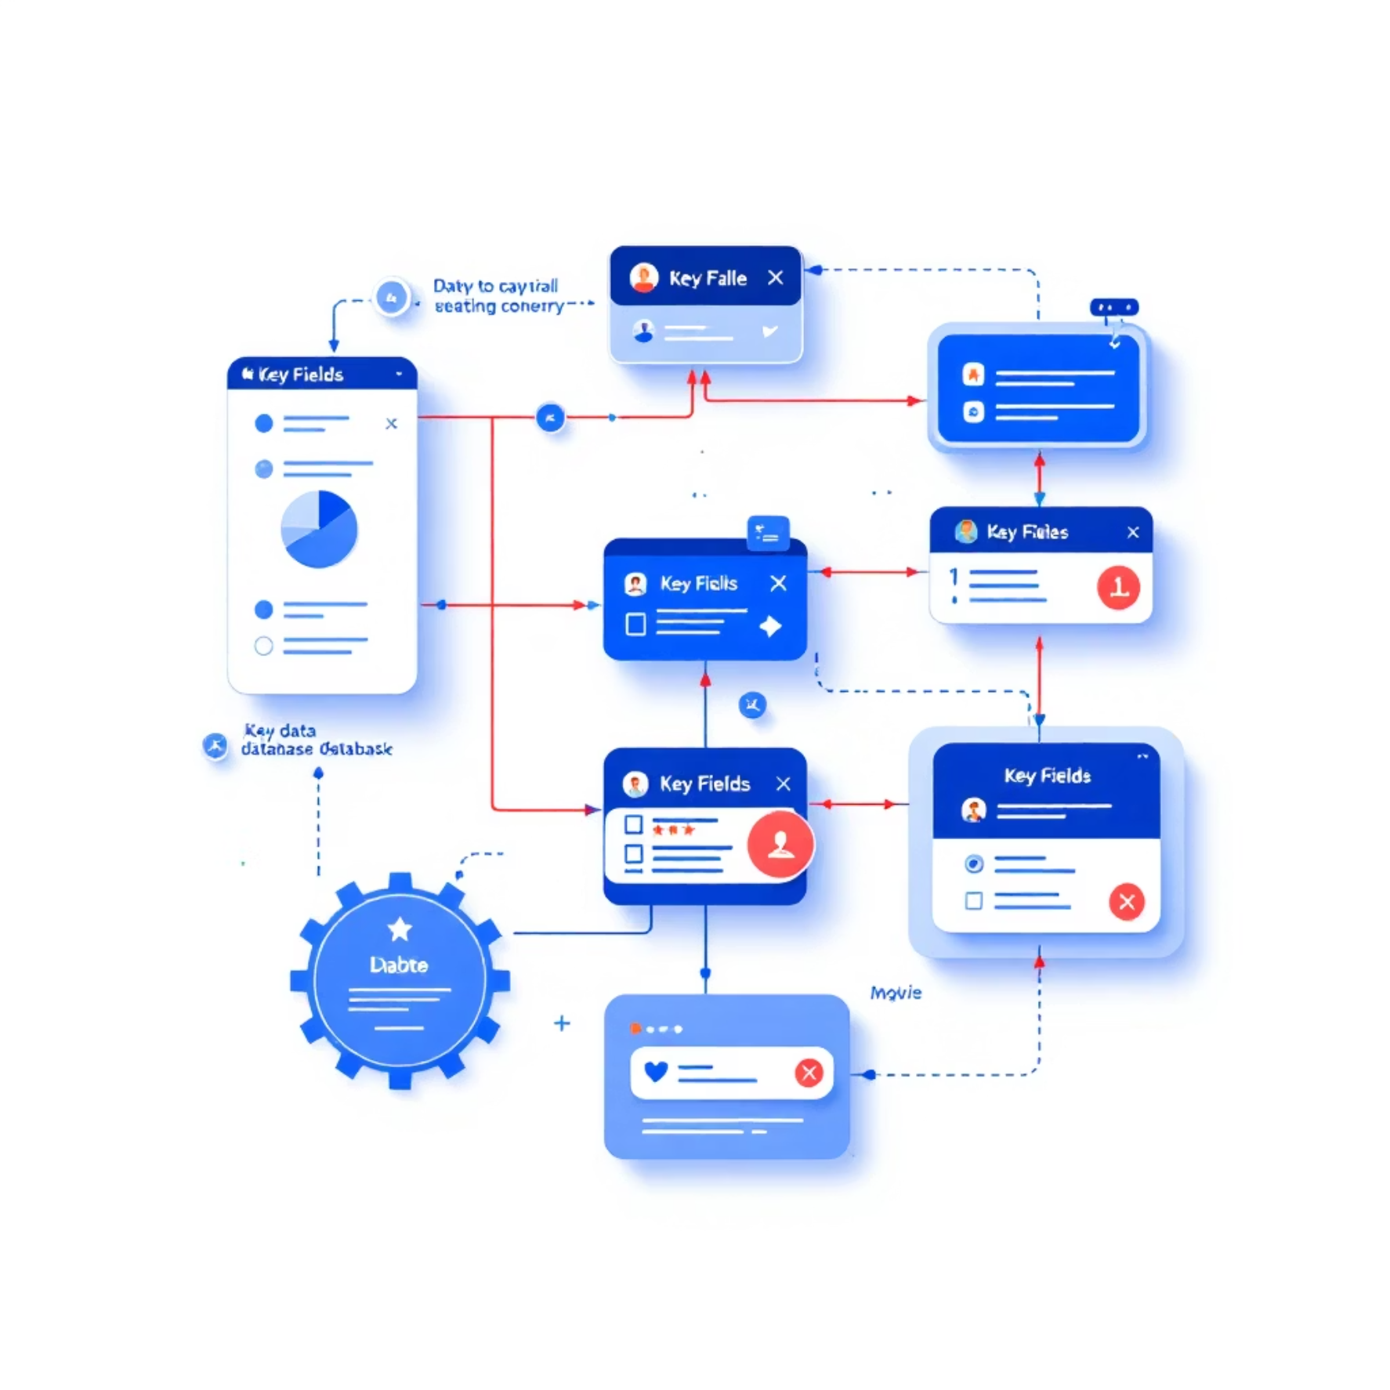
Database Foundation: PostgreSQL
PostgreSQL was strategically chosen as the database solution for Medizap due to its robust capabilities and open-source nature.
PostgreSQL provides advanced features like JSONB support, ensuring flexibility for evolving data structures, and strong transactional integrity for reliable data management. Its active community and extensibility were also key factors.
Schema Overview
The database schema is designed to efficiently store and manage all application data, including medicine details, cart contents, and user information.
medicines: Stores details of all available medications (name, stock, price).
carts: Manages individual shopping carts, linking to users.
cart_items: Details items within each cart, specifying medicine and quantity.

Slide 10



Future Vision & Conclusion
Medizap is designed with future expansion in mind, with several key areas identified for continued development to further enhance its capabilities.
Authentication System
Payment Gateway Integration
Advanced UI Enhancements
Implementing robust user authentication and authorization features to secure access and manage roles (e.g., admin, pharmacist, user).
Integrating secure payment processing options to facilitate direct purchasing within the application.
Further refining the user interface with advanced analytics dashboards and customizable reporting features for better insights.
Medizap successfully demonstrates a comprehensive, robust, and user-centric solution for medicine and cart management. This project served as an invaluable learning experience, reinforcing practical skills in full-stack development, system architecture, and project management. We are confident it lays a strong foundation for future advancements in digital healthcare solutions.
Thank You.

